Slide 1
Lecture 1
Intelligent Agents
Yaohang Li
Department of Computer Science
Old Dominion University
Reading for Next Class:
Chapter 3, Russell and Norvig
Syllabus

Slide 2
Review of Intelligent Agents
Motivation
Objectives
Introduction
Agents and Environments
Rationality
Agent Structure
Agent Types
  Simple reflex agent
  Model-based reflex agent
  Goal-based agent
  Utility-based agent
  Learning agent

Slide 3
Introduction to Intelligent Agents
Motivations
  agents are used to provide a consistent viewpoint on various topics in the field AI
  agents require essential skills to perform tasks that require intelligence
  intelligent agents use methods and techniques from the field of AI
What is an agent?
  in general, an entity that interacts with its environment
    perception through sensors
    actions through effectors or actuators
Agent and its environment
  an agent perceives its environment through sensors
    the complete set of inputs at a given time is called a percept
    the current percept, or a sequence of percepts may influence the actions of an agent
  it can change the environment through actuators
    an operation involving an actuator is called an action
    actions can be grouped into action sequences

Slide 4
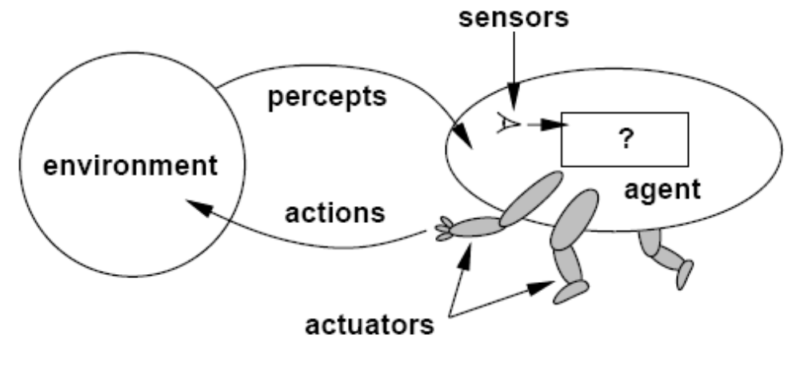
Intelligent Agents

Slide 5
Example of Agents
  human agent
    eyes, ears, skin, taste buds, etc. for sensors
    hands, fingers, legs, mouth, etc. for actuators
      powered by muscles
  robot
    camera, infrared, bumper, etc. for sensors
    grippers, wheels, lights, speakers, etc. for actuators
      often powered by motors
  software agent
    functions as sensors
      information provided as input to functions in the form of encoded bit strings or symbols
    functions as actuators
      results deliver the output

Slide 6
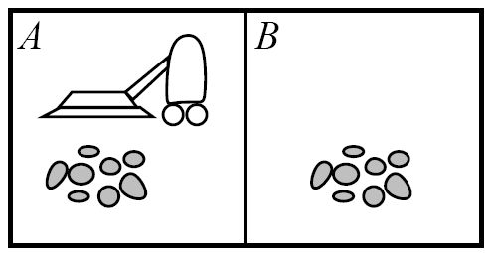
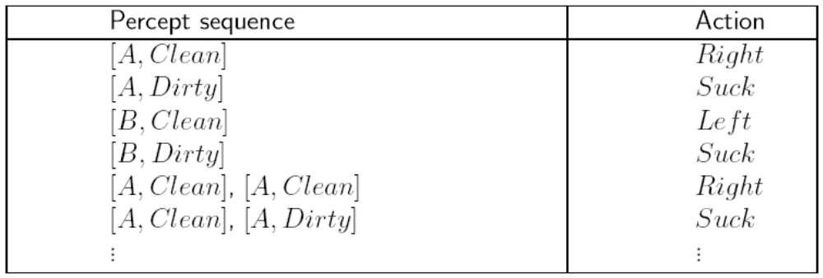
Vacuum-Cleaner World

Slide 7
Agents and Their Environment
a rational agent does “the right thing”
  the action that leads to the best outcome under the given circumstances
an agent function maps percept sequences to actions
  abstract mathematical description
an agent program is a concrete implementation of the respective function
  it runs on a specific agent architecture (“platform”)
problems:
  what is “ the right thing”
  how do you measure the “best outcome”

Slide 8
The Concept of Rationality
Concept of Rationality
  Rational ≠ omniscient
    Percepts may not supply all relevant information
  Rational ≠ clairvoyant
    Action outcomes may not be as expected
  Rational ≠ successful
  Rationality vs Perfection
    Rationality maximizes expected performance
    Perfection maximizes actual performance
  Rational → exploration, learning, autonomy

Slide 9
Performance Measure
Performance of Agents
  criteria for measuring the outcome and the expenses of the agent
    often subjective, but should be objective
    task dependent
    time may be important
Performance measure example
  vacuum agent
    Performance Measure: number of tiles cleaned during a certain period
      based on the agent’s report, or validated by an objective authority
      doesn’t consider expenses of the agent, side effects
        energy, noise, loss of useful objects, damaged furniture, scratched floor
      might lead to unwanted activities
        agent re-cleans clean tiles, covers only part of the room, drops dirt on tiles to have more tiles to clean, etc.
    Alternative Performance Measure:
      one point per square cleaned up in time T?
      one point per clean square per time step, minus one per move
      penalize for > k dirty squares?

Slide 10
Rational Agents
Rationality: selects the action that is expected to maximize its performance
  based on a performance measure
  depends on the percept sequence, background knowledge, and feasible actions
Performance measure for the successful completion of a task
  complete perceptual history (percept sequence)
  background knowledge
    especially about the environment
      dimensions, structure, basic “laws”
    task, user, other agents
  feasible actions
    capabilities of the agent
Definition of a Rational Agent
  For each possible percept sequence, a rational agent should select an action that is expected to maximize its performance measure, given the evidence provided by the percept sequence and whatever built-in knowledge the agent has.

Slide 11
The Nature of Environments
Environment
  determine to a large degree the interaction between the “outside world” and the agent
    the “outside world” is not necessarily the “real world” as we perceive it
  in many cases, environments are implemented within computers
    they may or may not have a close correspondence to the “real world”
Environment Properties
  fully observable vs. partially observable
    sensors capture all relevant information from the environment
  deterministic vs. stochastic (non-deterministic)
    changes in the environment are predictable
  episodic vs. sequential (non-episodic)
    independent perceiving-acting episodes
  static vs. dynamic
    no changes while the agent is “thinking”
  discrete vs. continuous
    limited number of distinct percepts/actions
  single vs. multiple agents
    interaction and collaboration among agents
    competitive, cooperative

Slide 12
Specifying the Task Environment (I)
PEAS Description
Performance Measures
used to evaluate how well an agent solves the task at hand
Environment
surroundings beyond the control of the agent
Actuators
determine the actions the agent can perform
Sensors
provide information about the current state of the environment

Slide 13
VacBot PEAS Description
Performance Measures
Environment
Actuators
Sensors
cleanliness of the floor
time needed
energy consumed
grid of tiles
dirt on tiles
possibly obstacles, varying amounts of dirt
movement (wheels, tracks, legs, ...)
dirt removal (nozzle, gripper, ...)
position (tile ID reader, camera, GPS, ...)
dirtiness (camera, sniffer, touch, ...)
possibly movement (camera, wheel movement)

Slide 14
SearchBot PEAS Description
Performance Measures
Environment
Actuators
Sensors
number of “hits” (relevant retrieved items)
recall (hits / all relevant items)
precision (relevant items/retrieved items)
quality of hits
document repository (data base, files, WWW, ...)
computer system (hardware, OS, software, ...)
network (protocol, interconnection, ...)
query functions
retrieval functions
display functions
input parameters

Slide 15
Chess Player PEAS Description
Winning the game
Time spent in the game
Performance Measures
Environment
Actuators
Sensors
Chessboard
Positions of every piece
Move a piece
Input from the keyboard

Slide 16
Specifying the Environment (II)
PAGE Description: used for high-level characterization of agents
Percepts
information acquired through the agent’s sensory system
Actions
operations performed by the agent on the environment through its actuators
Goals
desired outcome of the task with a measurable performance
Environment
surroundings beyond the control of the agent

Slide 17
VacBot PAGE Description
Percepts
Actions
Goals
Environment
tile properties like clean/dirty, empty/occupied
movement and orientation
pick up dirt, move
desired outcome of the task with a
measurable performance
surroundings beyond the control of the agent

Slide 18
StudentBot PAGE Description
images (text, pictures, instructor, classmates)
sound (language)
Percepts
Actions
Goals
Environment
comments, questions, gestures
note-taking (?)
mastery of the material
performance measure: grade
classroom

Slide 19
Agent Program
the emphasis in this course is on programs that specify the agent’s behavior through mappings from percepts to actions
  less on environment and goals
agents receive one percept at a time
  they may or may not keep track of the percept sequence
performance evaluation is often done by an outside authority, not the agent
  more objective, less complicated
  can be integrated with the environment program
Basic Framework
function SKELETON-AGENT(percept) returns action
static: memory
memory := UPDATE-MEMORY(memory, percept)
action := CHOOSE-BEST-ACTION(memory)
memory := UPDATE-MEMORY(memory, action)
return action

Slide 20
Agent Program Types
Classification of Agent Programs
  different ways of achieving the mapping from percepts to actions
  different levels of complexity
Agent Program Types
  simple reflex agents
  agents that keep track of the world
  goal-based agents
  utility-based agents
  learning agents

Slide 21
Simple Reflex Agents
Simple Reflex Agents
  requires processing of percepts to achieve some abstraction
  Select actions on the basis of the current percept, ignoring the rest of percept history
  frequent method of specification is through condition-action rules
    if percept then action
  similar to innate reflexes or learned responses in humans
  efficient implementation, but limited power
    environment must be fully observable
    easily runs into infinite loops
application of simple rules to situations
function SIMPLE-REFLEX-AGENT(percept) returns action
static: rules //set of condition-action rules
condition := INTERPRET-INPUT(percept)
rule := RULE-MATCH(condition, rules)
action := RULE-ACTION(rule)
return action

Slide 22
Simple Reflex Agent
Sensors
What the world is like now
Environment
Condition-action rules
Agent
What should I do now
Actuators

Slide 23
Model-based Reflex Agents
an internal state maintains important information from previous percepts
  sensors only provide a partial picture of the environment
  helps with some partially observable environments
  Keep track of the percept history
the internal states reflects the agent’s knowledge about the world
  this knowledge is called a model
  may contain information about changes in the world
    caused by actions of the action
    independent of the agent’s behavior
application of simple rules to situations
function REFLEX-AGENT-WITH-STATE(percept) returns action
static: rules //set of condition-action rules
state //description of the current world state
action //most recent action, initially none
state := UPDATE-STATE(state, action, percept)
rule := RULE-MATCH(state, rules)
action := RULE-ACTION[rule]
return action

Slide 24
Model-based Reflex Agents
Sensors
States
What the world is like now
How the world evolves
What my actions do
Condition-action rules
What should I do now
Agent
Actuators
Environment

Slide 25
Goal-based Agent
the agent tries to reach a desirable state, the goal
  may be provided from the outside (user, designer, environment), or inherent to the agent itself
results of possible actions are considered with respect to the goal
  easy when the results can be related to the goal after each action
  in general, it can be difficult to attribute goal satisfaction results to individual actions
  may require consideration of the future
    what-if scenarios
    search, reasoning or planning
very flexible, but not very efficient

Slide 26
Goal-based Agent
Sensors
State
What the world is like now
How the world evolves
What happens if I do an action
What my actions do
Goals
What should I do now
Agent
Actuators
Environment

Slide 27
A Utility-based Agent
more sophisticated distinction between different world states
  a utility function maps states onto a real number
    may be interpreted as “degree of happiness”
  permits rational actions for more complex tasks
    resolution of conflicts between goals (tradeoff)
    multiple goals (likelihood of success, importance)
    a utility function is necessary for rational behavior, but sometimes it is not made explicit

Slide 28
A Utility-based Agent
Sensors
State
What the world is like now
How the world evolves
What happens if I do an action
What my actions do
How happy will I be then
Utility
What should I do now
Agent
Actuators
Environment

Slide 29
Learning Agent
performance element
  selects actions based on percepts, internal state, background knowledge
  can be one of the previously described agents
learning element
  identifies improvements
critic
  provides feedback about the performance of the agent
  can be external; sometimes part of the environment
problem generator
  suggests actions
  required for novel solutions (creativity)

Slide 30
A Model of a Learning Agent
Performance
Standard
Sensors
Critic
State
What the world is like now
Learning
Element
How the world evolves
What happens if I do an action
What my actions do
How happy will I be then
Utility
What should I do now
Problem
Generator
Agent
Actuators
Environment

Slide 31
Summary
agents perceive and act in an environment
  Definition of Percept
  Description of the environment (PEAS)
ideal agents maximize their performance measure
  Rationality
  Performance Measure
  Rational Agent
basic agent types
  simple reflex
  reflex with state
  goal-based
  utility-based
  learning
some environments may make life harder for agents
  inaccessible, non-deterministic, non-episodic, dynamic, continuous

Slide 32
What I want you to do
Review Chapter 2
Review Class Notes
Build a Project Team

